Slide 1


Government Polytechnic Adityapur
Report on IN-PLANT TRAINING
Name: sachin buriuly
Branch:cse
Roll No.:LE-07

Slide 2
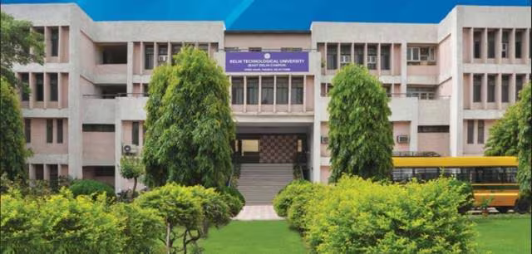
Delhi University Website Design
This in-plant training focuses on building a Delhi University website using HTML and CSS. We'll cover design, layout, color selection, and common mistakes to avoid.

Slide 3

Designing the Website
Planning
Start with wireframing and planning. Define the website's structure and content.
HTML Structure
Use semantic HTML5 elements. Create a solid foundation for your design.
CSS Styling
Apply styles with CSS. Ensure consistency and visual appeal.
Spacing and Padding
Use appropriate spacing to improve readability. Create visual hierarchy.

Slide 4

Dimensions and Layout
Responsive Design
Ensure your website adapts to different screen
sizes. Use media queries for responsiveness.
Layout
Use a grid system or flexbox for a structured layout. Consider user flow and navigation.

Slide 5

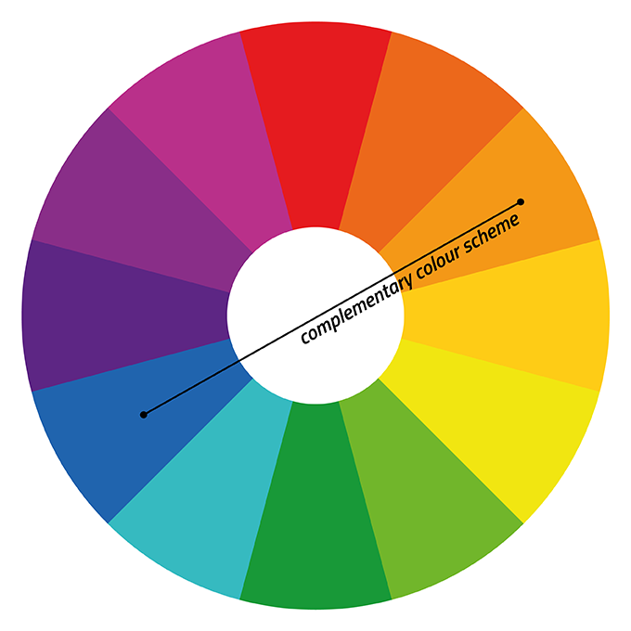
Color Selection
Brand Colors
Use Delhi University's official colors. Maintain brand consistency.
Color Harmony
Choose colors that work well together. Ensure visual appeal and readability.
Accessibility
Consider color contrast for accessibility. Use sufficient contrast between text and background.

Slide 6

Avoiding Common Mistakes
Broken Links
Regularly check for broken links. Ensure all links are functional.
Poor Readability
Use appropriate font sizes and line heights. Ensure good contrast.
Slow Loading Times
Optimize images and code. Improve website performance.

Slide 7

Enhancing User Experience
Intuitive Navigation
Make navigation clear and easy to use. Users should easily find information.
Clear Calls to Action
Use clear calls to action. Guide users towards desired actions.
Accessibility
Ensure the website is accessible to everyone. Follow accessibility guidelines.

Slide 8
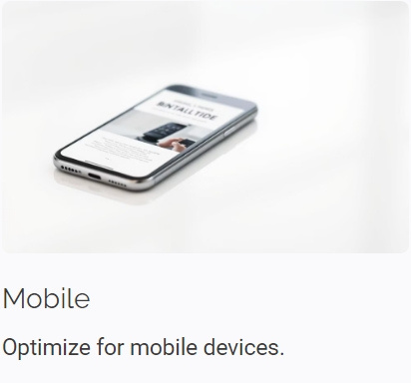
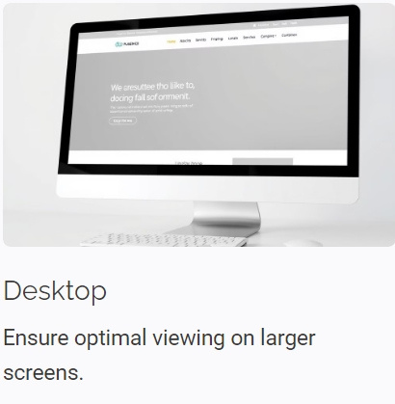
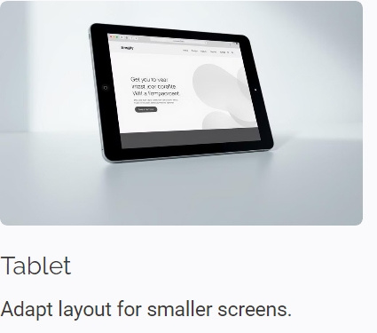
Optimizing for Different Devices

Slide 9
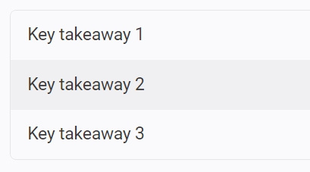
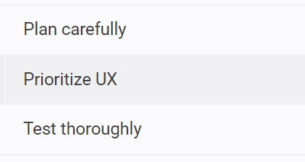
Conclusion and Key Takeaways

Slide 10
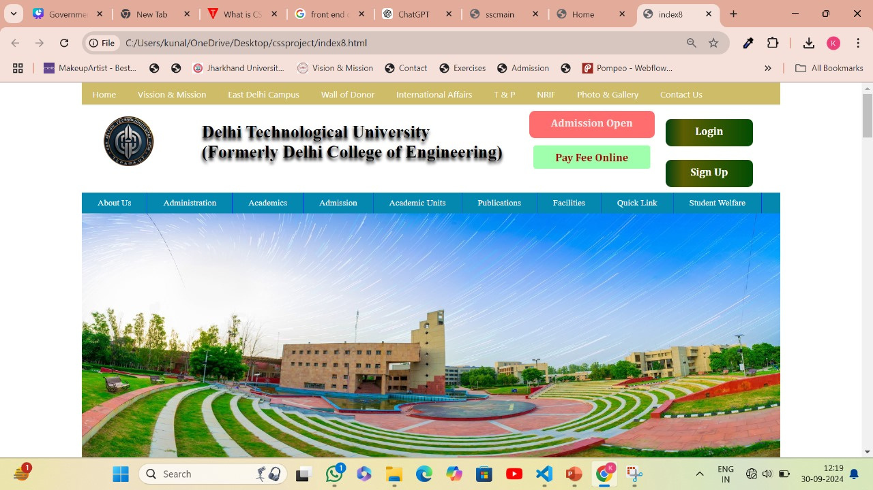
Lets explore the website through photos

Slide 11
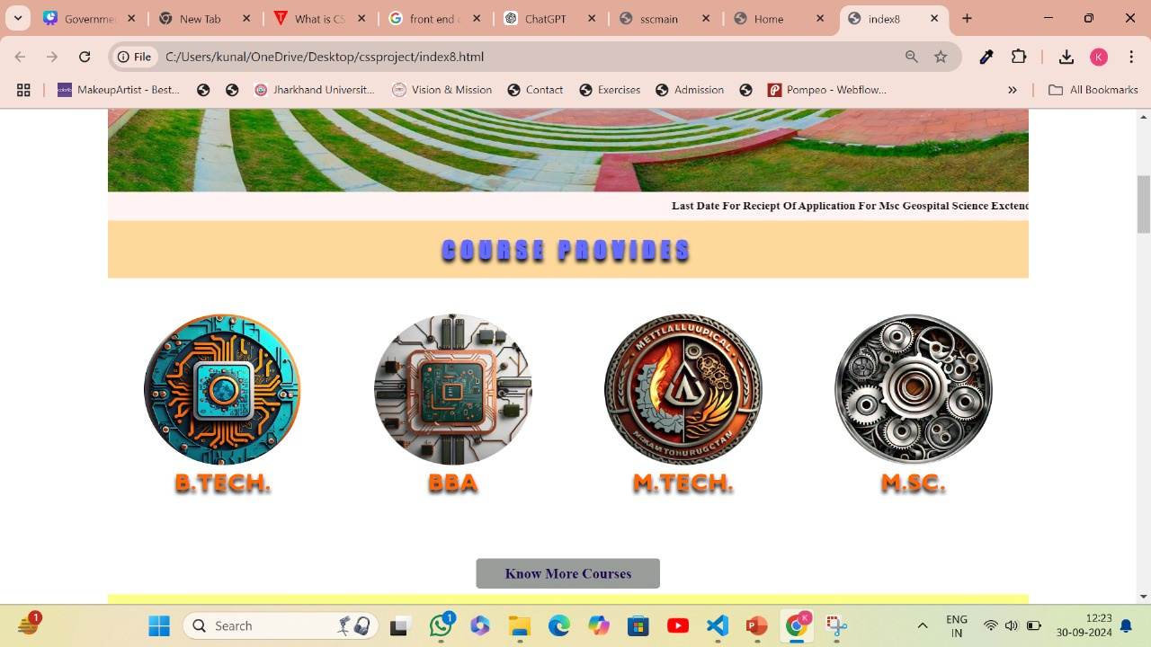
Lets explore the website through photos

Slide 12
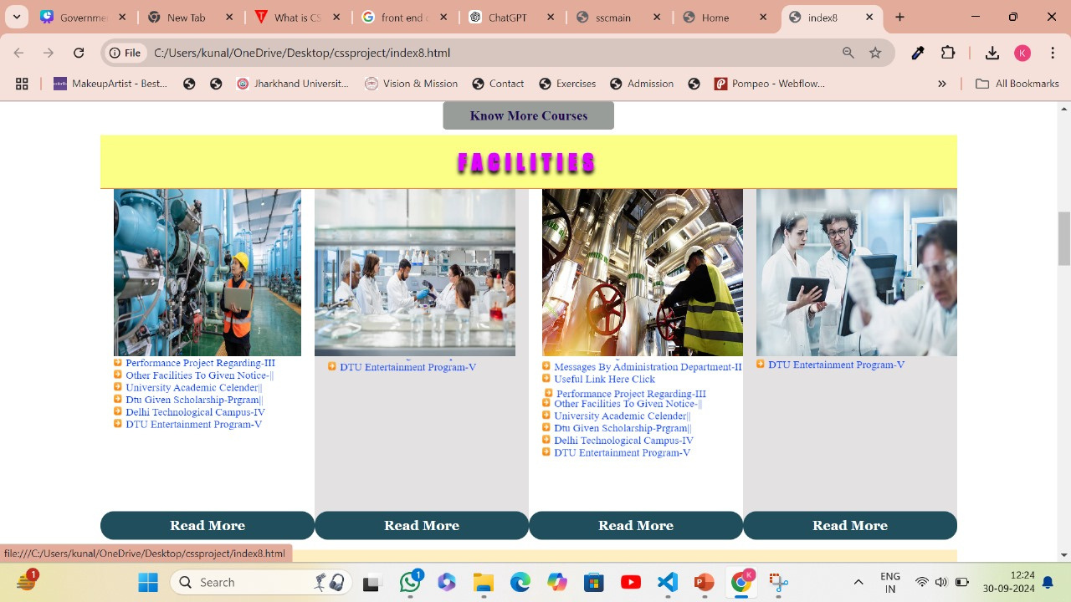
Lets explore the website through photos

Slide 13
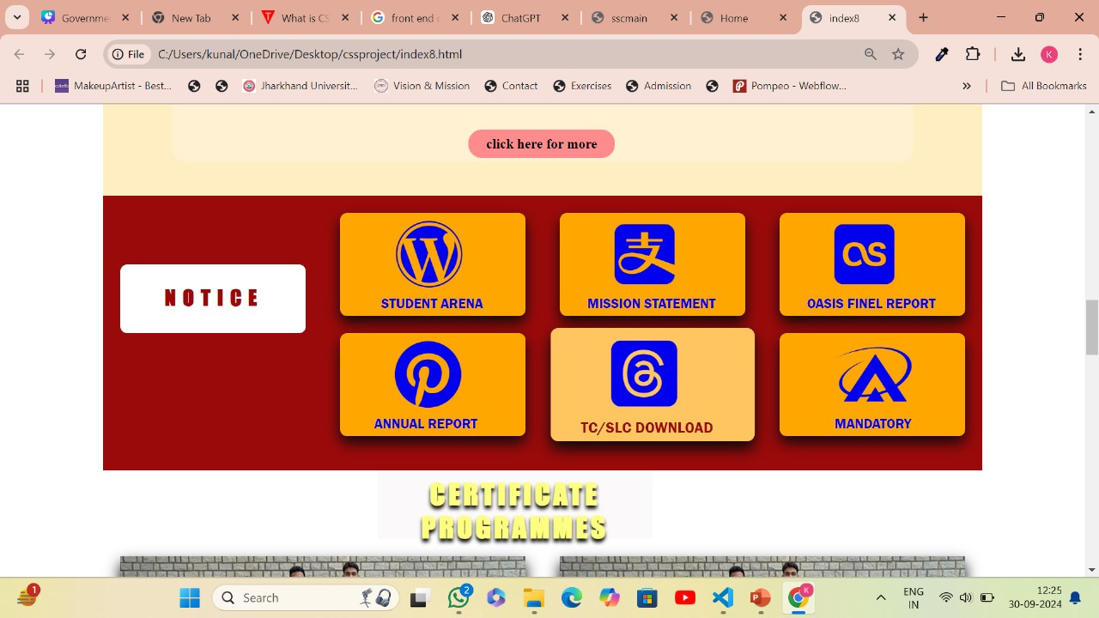
Lets explore the website through photos

Slide 14
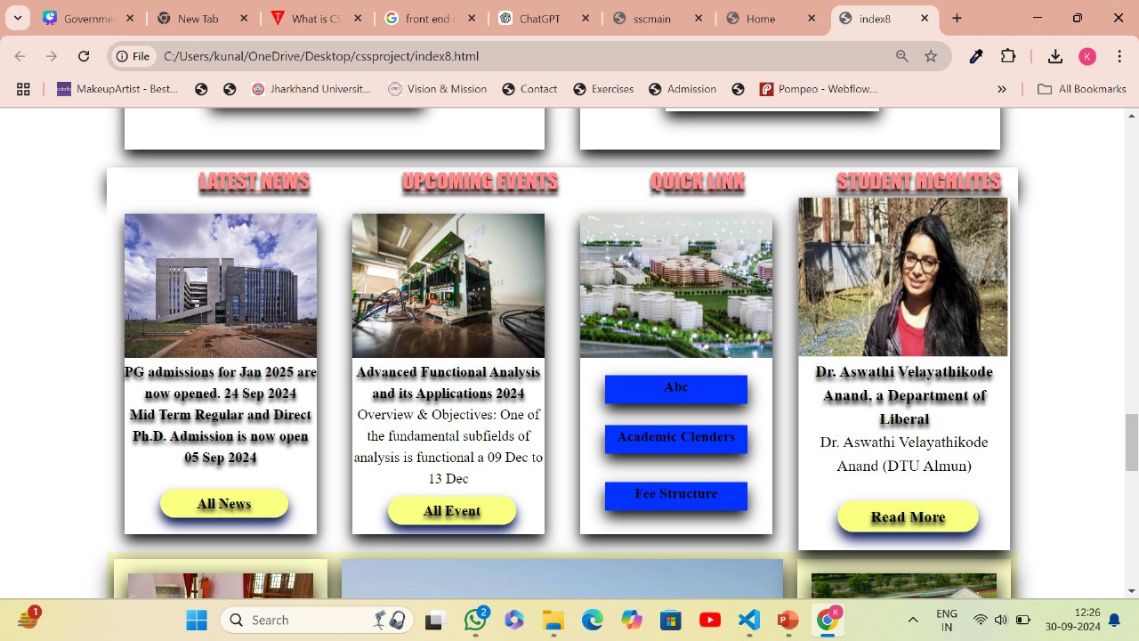
Lets explore the website through photos

Slide 15
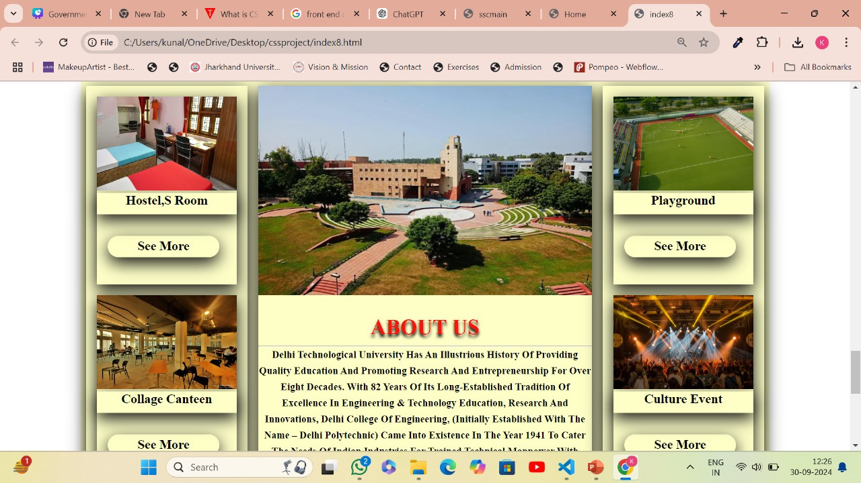
Lets explore the website through photos

Slide 16
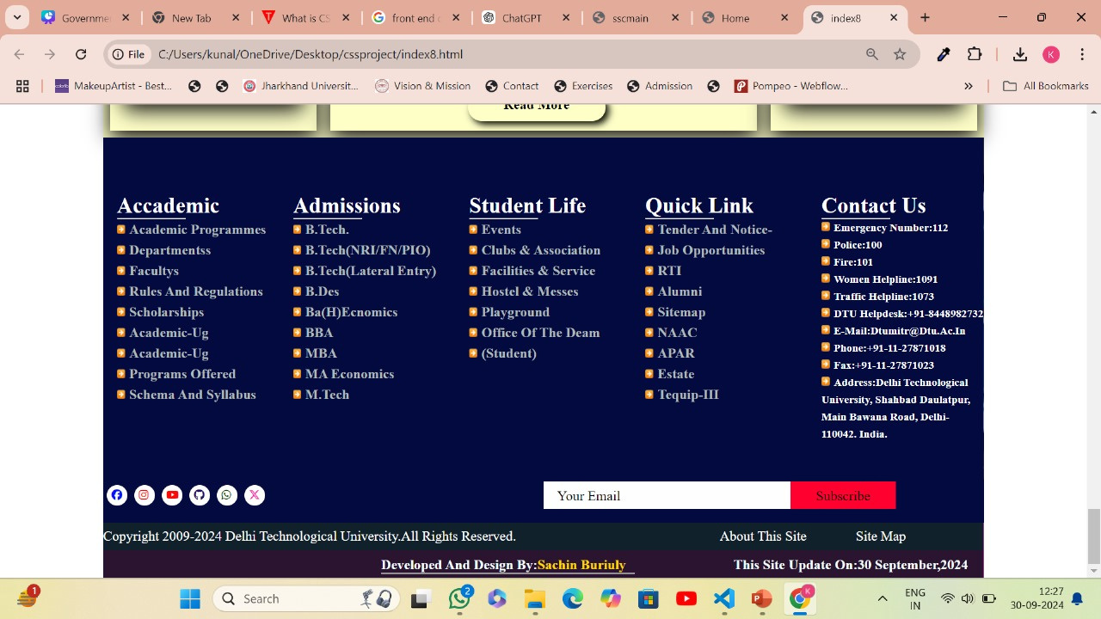
Lets explore the website through photos

Slide 17


Slide 18
Lets explore the website through photos

